Slide 1
Reducing Pipeline Stalls: Branch Prediction

Slide 2
Team members
1-Goda Saber Goda
2-Hamed Essam Hamed
3-Mohamed Waheed
4-Mohamed Ahmed
5-Nadia Kamel

Slide 3
Objective of the Assignment
Understand techniques to reduce pipeline stalls
Implement and evaluate branch prediction
Explore BTB and Return Address Stack enhancements

Slide 4
Pipeline Baseline Assumptions
5-stage pipeline (IF, ID, EX, MEM, WB)
Perfect I/D cache, result forwarding
Split-phase register access
Branch resolved in EX stage

Slide 5
Control Hazard Problem
Branches cause 2-cycle penalties if taken
Fall-through path fetches cause wasted cycles
Need to predict and minimize stalls

Slide 6
Introduction to Branch Prediction
Predict direction in ID stage
Update fetch_pc early if predicted taken
Only mispredicted branches updated in EX stage

Slide 7
Bimodal Branch Prediction
It predicts whether a branch (like an if statement) will be taken or not taken the next time it's encountered.It uses a single-bit or 2-bit counter for each branch instruction, stored in a Branch History Table (BHT).This predictor is "bimodal" because it considers two outcomes only: taken or not taken — the two "modes."How It Works:The CPU keeps a table indexed by the address of the branch instruction.For each branch, it stores a counter:In a 1-bit predictor: 1 = taken, 0 = not taken.In a 2-bit predictor: more robust to change; needs two wrong predictions to switch direction.When the branch is encountered again, the CPU uses this table to predict the outcome
.Pros:Simple and fast.Effective for branches that behave consistently (e.g., always taken or always not taken).Cons:Poor at predicting loops or alternating branches, since it doesn't account for past behavior beyond the last outcome

Slide 8
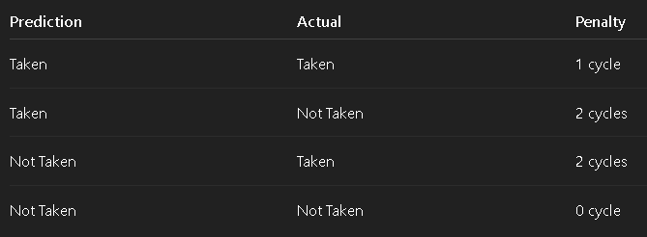
Prediction Penalty Table

Slide 9
2 level branch prediction
Level 1:
Branch History TrackingPurpose: Capture the recent behavior pattern of branches
- Components:
Branch History Register (BHR):A shift register that records recent branch outcomes (1 for taken, 0 for not taken)
For local history predictors: Each branch has its own BHR
For global history predictors: All branches share one BHR
- Example: BHR value 1010 means the pattern Taken, Not taken, Taken, Not taken
- Branch History Register Table (BHRT):In local history predictors, this table stores BHRs indexed by branch address
-Size determines how many branches can have unique historie

Slide 10
2 level branch prediction
Level 2:
Pattern-Based PredictionPurpose: Use the history patterns to make predictions
Components:
Pattern History Table (PHT): Contains 2-bit saturation counters that make actual predictions
Indexed by the BHR value (or a hash of BHR and branch address)
Each counter has 4 states: 00 (strong not-taken) → 11 (strong taken)Prediction
- Mechanism:
Current BHR selects a PHT entry
The 2-bit counter in that entry makes the prediction
- Example: If BHR=1010 indexes to PHT entry with value 10, predict "taken"

Slide 11
2 level branch prediction
Operation Cycle:
Prediction Phase:
Branch address → Index into BHRT (for local history)
Retrieve BHR value
BHR value → Index into PHT
PHT entry provides prediction
Update Phase (after branch resolves):
Update the BHR: Shift in the actual outcome (1 or 0)
Update the PHT counter:
Increment if taken (up to max of 11)
Decrement if not taken (down to min of 00)

Slide 12
Predictors Implemented
2-bit Saturating Counter: BPred2Bit
Correlating Predictor (2,2): BPred2Level
Compare performance of both

Slide 13
Branch Target Buffer (BTB)
Cache of target addresses
Used in IF stage
Combined with predictor for faster decision

Slide 14
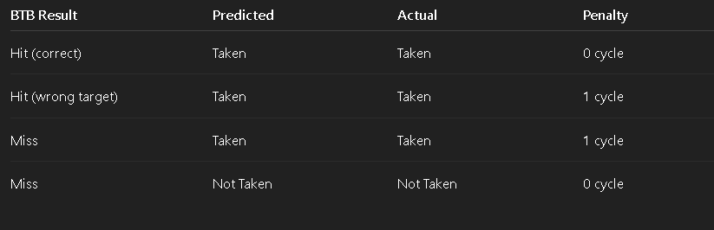
BTB Prediction Penalties Table

Slide 15
Return Address Stack (RAS)
What is the Return Address Stack (RAS)?
The Return Address Stack is a hardware stack that keeps track of return addresses for function calls.
It is a key component in modern CPU pipelines, especially in superscalar and pipelined architectures,
to support accurate return address prediction during speculative execution

Slide 16
How Does RAS Work?
On a function call:Push the return address (PC of the next instruction) onto the RAS.
On a return:Pop the top of the RAS and predict that as the return address.
This works well because function calls and returns are nested, much like how a stack works.

Slide 17
Pros and Cons
Pros of RAS
1. High Accuracy for Return PredictionRAS
2. Improved Pipeline
3. Low Latency
Cons of RAS
Limited Depth
Vulnerability to Mismatched Call/Return
Not Effective for Indirect Returns

Slide 18
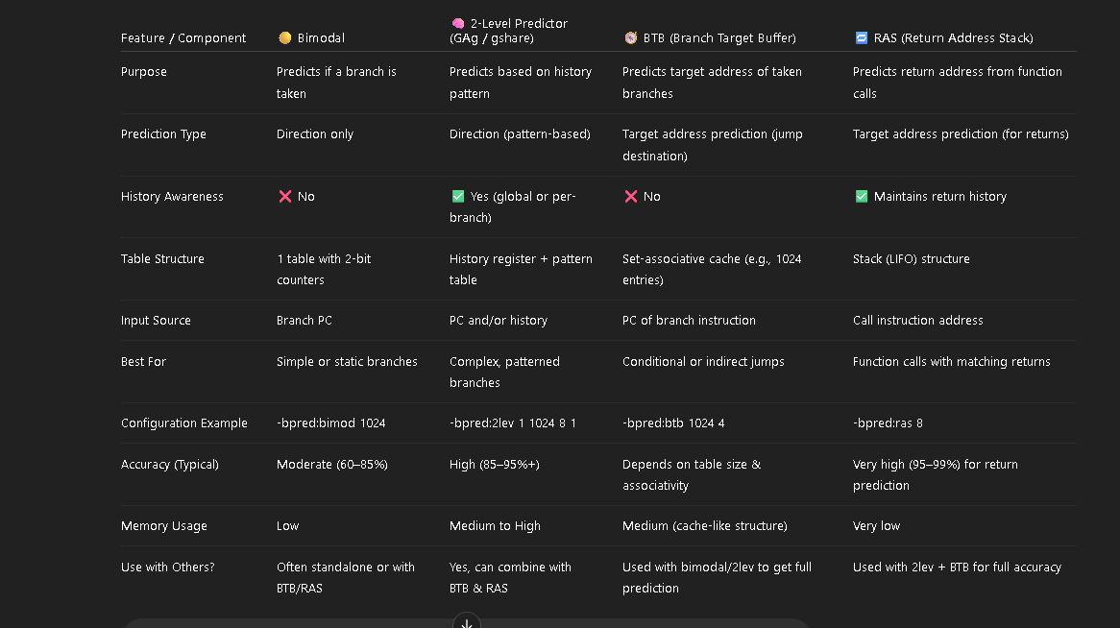
Comparison between branching techniques

